Slide 1
Oscillator FUNDAMENTALS
CHAP-1 Razavi PLL
Deepa Kulkarni
Guided by: Neeraj Mishra sir, BITS PILANI

Slide 2
Presentation agenda
Basic Oscillator Concepts
Oscillatory Feedback Systems
Ring Oscillators
LC Oscillators
Voltage-Controlled Oscillators

Slide 3
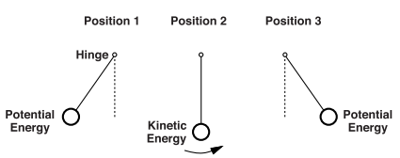
Basic Oscillator Concepts
Oscillators? – A system that produces repeated motion.
Oscillatory system:
Initial Imbalance- an initial condition - To start the motion
Energy Conversion
Sustaining – to sustain the Oscillations- requires periodic Pushes
Lossless Oscillators
Ideal case -> no friction -> no loss
A gentle push can increase/decrease Osc freq based on the frequency with which push is generated.

Slide 4
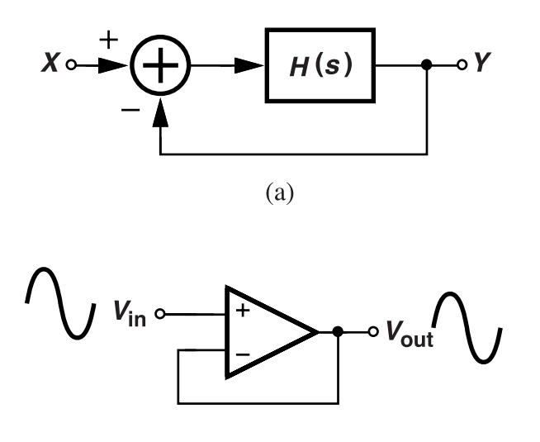

Oscillatory Feedback System
Feedback System:
Amplifier(or any block) → Output → Feedback Network → Input.
Negative Feedback: A block with transfer function H(s), o/p is Fed back to the input, but it opposes the input creating a negative feedback.
Oscillation condition: (Barkhausen Criterion) :
Oscillation occurs when the system outputs a sinusoid without input i.e., X(s) = 0, but Y(s) ≠ 0 }.
Denominator: 1+H(s)=0 => H(s)=−1 Infinite gain at ω₀ .
s = jω₀, this means:
|H(jω₀)| = 1 (unity gain)
∠H(jω₀) = 180° (phase shift)
linear feedback system:
transfer function
IDEALLY,
Any small input/noise→ noise gets amplified
→ self-sustaining oscillation.

Slide 5
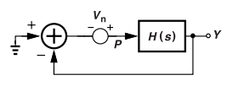
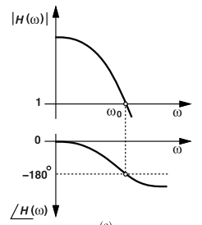
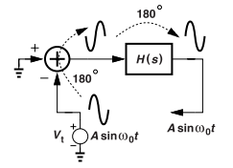
Deeper Understanding
At lower frequencies, Op-amp is exceptionally stable and has negligible phase shift.
Analysis of oscillators using Small signal model conditions to check :-
Oscillation Test via Impedance:
Inject a sinusoid Vn , anywhere inside the loop and observe the response at any other point in the loop.
If the impedance → ∞ at some frequency ω₀, the circuit is capable of oscillation.
Open Loop gain Analysis:
Gain at freq ‘w’ is 1
Total phase shift is 180 degrees
Feedback’s inherent phase shift is 180 degrees
Initial Condition response ( Impulse/start from rest)
Goal is to check if the circuit naturally oscillates.
A signal is injected/ capacitor value is assumed.
Noise is inserted
into the circuit
Phase and mag graph

Slide 6
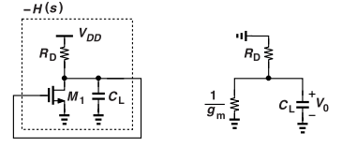

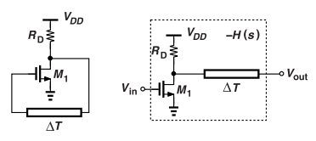
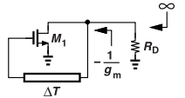


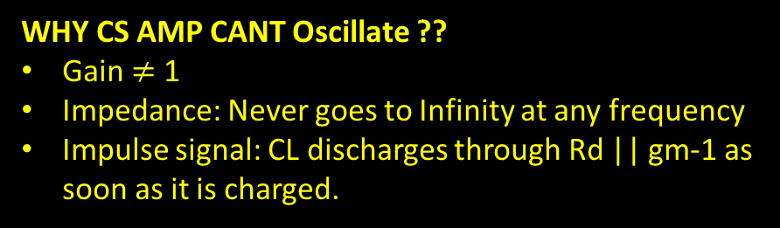
CS Amp with feedback
The transfer function :
The denominator : [RdCS +1 ] : indicates Only one pole.
Maximum phase shift = -90 degrees at Infinite Freq.
CS Amp with Delay Line
Insert pure delay ΔT between drain and gate
Open‑loop Method:
H(s) = gm Rd $e^{−\text{sΔT}}$.
Barkhausen at ω₀ gives :
      Magnitude: gmRD=1 (start‑up condition)
      Phase: ω₀ ΔT = π (gives the missing –90 °)
      period equals 2ΔT
2. Impedance Method:
The transfer function : $⇒$ Z=−1/g m​ at ω₀;
Loop acts like –RD, canceling load loss when 𝑔𝑚𝑅𝐷=1
WHY CS AMP CANT Oscillate ??
Gain $≠$ 1
Impedance: Never goes to Infinity at any frequency
Impulse signal: CL discharges through Rd || gm-1 as soon as it is charged.
Delay Line
the system has enough phase shift and gain to oscillate.

Slide 7
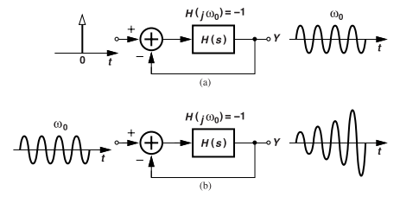
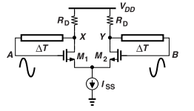
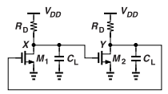

Osc growth
Impulse start: constant‑amplitude sinusoid (ideal lossless)
Sinusoid at ω₀: amplitude grows until limited by non ‑ linarites.
Differential pair with feedback delay lines.
gmRD = 1 and Va & Vb swing differentially
In small signal : Oscillations occur due to near-unity voltage gain.
In large signal : No oscillations as non-linear behavior observed reduces the gain.
Large swing Differential Oscillators
VA – VB swings fully: ISS steered completely left or right.
  Voltage swing is : $V_{0}=\left(\sqrt{2}V_{GS}−V_{TH}\right)=ISS⋅R D​ ⇒ g_{m}R_{D}=\sqrt{2}$
  $g_{m}R_{D}>1$ and there’s a 180° phase shift
if H(jω0)=−2, closed-loop gain is 2 ;
  no steady oscillation at ω₀ ; H(s1) = −1, where s1 has a complex value
Latch-up Due to Positive Feedback at DC: Two CS stages
At positive DC feedback, If Gain > 1 ⇒ VX↑ → VY↓ → VX↑ more → Signal REGENERATES.
Until VX=Vdd & VY=0 turning M1 off → LATCH UP → acts like SR latch or memory cell
  Complex frequency leads to OSCILLATION GROWTH

Slide 8
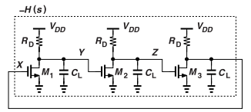
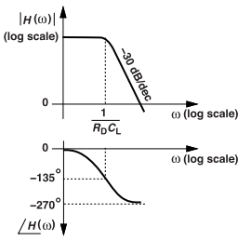


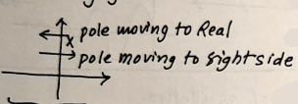


Basic Ring Oscillators
3‑Stage (and N‑Stage) Ring Oscillator Essentials
Why 3 stages?
1 stage → only -90 ° ; 2 stages → −180 ° only at infinite frequency ; 3 CS stages give −180 ° (−60 ° each + inversions) .
Phase : $\tan^{−1}\left(R_{D}C_{L}w_{0}\right)=60$ degrees.
$w_{0}=\frac{\sqrt{3}}{R_{D}C_{L}}$ and $A_{0}=2 \text{(}\text{low}\text{‑}\text{f} \text{gain}\text{ = 2 }\text{per} \text{stage}\text{).}$
General odd‑N ring :
Phase per stage: −180°/N
Freq: Gain:
Amplitude growth :
Need $A_{0}=2$ per stage; poles move to right‑half plane → oscillation builds from noise.
Using non‑linearities ; oscillations are maintained; drags the average loop gain to 1.
Derived from the conditions:
|H(jω₀)| = 1 & $∠\text{H}\text{(}\text{jω}\text{₀) = − 180}$◦
  As N increases, the required low-frequency gain decreases.
Design takeaway:
To avoid latch-up, at dc, the feedback is negative or, if positive, loop gain < < 1
For reliable start‑up target sufficient small‑signal gain
but rely on non‑linear limiting for full rail‑to‑rail swings and crisp transitions.

Slide 9
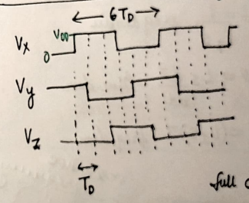

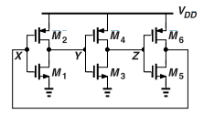

Inverter-Based Rings
CMOS inverters replace CS stages with → higher gain, compact design.
Negative Feedback at DC (freq=0) prevents LATCH-UP condition.
Frequency Estimates:
  Small-signal: $w_{0}=\frac{\sqrt{3}}{(r_{on}{||r}_{op})C_{L}}$ & Large-signal: $f0=\frac{1}{6T_{D}}$→ more accurate
  Td = delay of 1 inverter
  6Td = Total oscillation.
Properties :
  Frequency & supply voltage Vdd : $f0↑ ⇒Td ↓ ⇒Vdd↑$
  Average power :$Pavg=f0∗CL∗{Vdd}^{2}$
  $Pt\left(total power\right)=n∗f0∗CL∗{Vdd}^{2}$
NOTE : No initial conditions are required, starts oscillating regardless.
  Each gain stage Ao >> 2

Slide 10

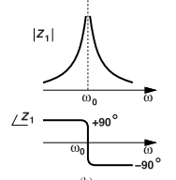
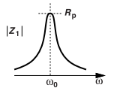
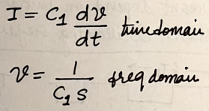
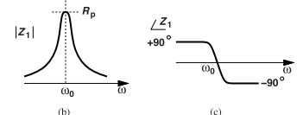
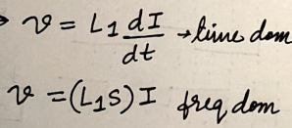
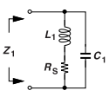

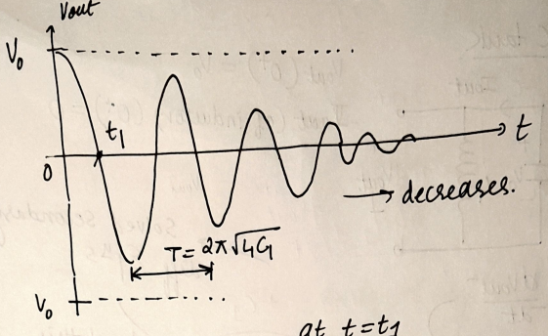




BASIC LC OSCILLATORS
|Z1|: Magnitude
|Z1|: Magnitude
Ideal Parallel LC Tank (Resonator):
  Capacitors:
  Inductors :
  At Low frequency: ​ ω<ω0 ⇒ tank acts like a inductor
  At high frequency: ω>ω0 ⇒ tank acts like a capacitor
  At ω = ω0 ⇒ Resonance frequency => ω0 = $\frac{1}{\sqrt{LC}}$
Lossy Parallel LC tank and quality factor:
series loss 𝑅s​ → “lossy” tank
a lower RS or a higher Rp
translates to a more ideal tank.
Ideal parallel LC tank
Phase plot: +90 ° → –90 °
sharp transition at ω0​
$$∠Z1 :Phase$$
$$∠Z1 :Phase$$
Equivalent
Lossy parallel LC tank
Oscillations slowly Die

Slide 11



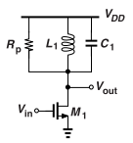
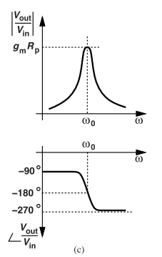
Quality Factor :
  Figure of “ goodness” of inductors
  Q : High for Ideal Inductors & Low as we include Losses
  Series resistance =>
  Parallel Resistance =>
LC Tank as Tuned Load / Amplifier :
A LC-tank is used as a “ load ” to CS amplifier.
At w0 ; Gain : Vout​/Vin ​= −gm​Rp, & phase = 180 ° (by CS stage only)
DC behavior at freq = 0:
  inductor ≈ shorted → output bias ≈ VDD ​;
Acts like band‑pass filter centered at ω0.
The Q rises linearly with ω if Rs is assumed independent of the frequency
Rp = ∞ leads to an ideal parallel tank.
Q at the resonance frequency
  Q can be viewed as proportional to the slope of the phase response.

Slide 12
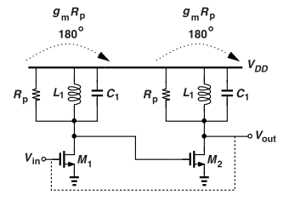
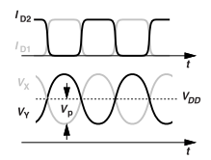
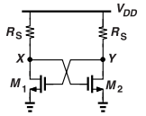

LC Oscillators as Feedback Systems
Two cascaded tuned CS stages in a loop :
  360 degree phase shift &
  ${\text{(}\text{gmRp}\text{)}}^{2}≥1$
  Since, gain is sufficiently large ;
    VX falls and VY rises, M2 begins to turn off and M1 turns on more. The drain currents therefore swing between 0 and Vdd.
Latch-up conditions and how to avoid them :
At DC : Inductor is shorted , Has a resistance Rs , NO oscillations !
At small signals :
  The circuit effectively turns into a 2-stage CS amp with feedback => eventually LATCH-UP
How to avoid latch up ? : ${\text{(}\text{gmRp}\text{)}}^{2} < 1$ ; gm →chosen carefully ; Rs→ Small
LC oscillator equivalent circuit
at low frequencies

Slide 13
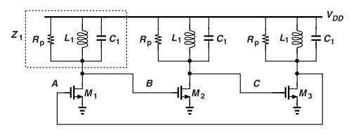

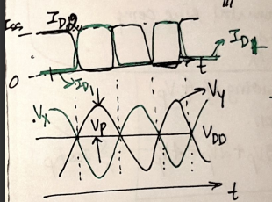
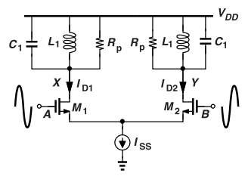

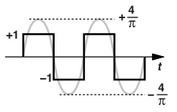

3-stage LC Osc & Differential Feedback Oscillators
Gain
3-stage LC Oscillator:
each stage contributes −120 ◦
VB /VA = −gmZ1,
$∠$(−gmZ1) = −120 ◦
Differential pair with LC loads
Small signal diff gain => A0 = -gmRp (at w0)
Large signal sine input at w0:
  -M1 and M2 completely switch alternatively.
  -Id1 and Id2 alternate b/w 0 and Iss
  -Output swing: Fundamental swing amp >> sq wave amp
  Sine Amplitude = 4 / pi
  For Id1 and Id2 : 2 Iss / Rp
Alpha is a function of Q
Single-ended peak Voltage
differential peak-to-peak swing = (8/π)* ISS* Rp
Vpp = 2Vp +2 Vp ; ⬅ X&Y have +/- Vp

Slide 14
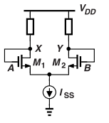
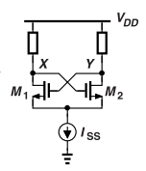

Cross-coupled Oscillators
Negative feedback :
No phase shift
No oscillations
At w0, only 180 degrees phase shift.
Positive feedback / Cross Coupled osc:
360 degrees phase shift
  Amplifiers provide : 180
  Feedback provides : 180
VX $↑$ VY $↓$ ……. M1 off => ID1 drops => VX increases more. (Vx = Vdd- Id1Rp)
As Vs increases ; M2 more active = > Id2 increases.
Id2 decreases = > Vy starts dropping more = > M1 voltage drops = > increases ID1
Id1 up; Vx down ; M2 down ; Vy increases and so on….
These act as Negative Resistance when Voltage decreases and the current increases (small-signal)

Slide 15
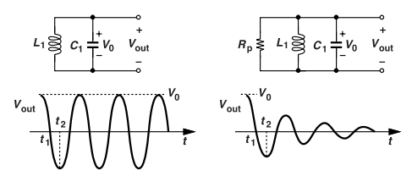
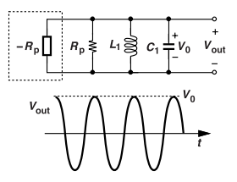
One-port systems
Ideal and Lossy LC Oscillators:
Oscillators are seen as One-port systems instead of feedback
Ideal Oscillators :
  At t1: Energy of cap = 0 ; energy of inductor = (½)*L*(I^2)
  At t2, Vout= -Vo ; Full energy in cap and zero in ind
Lossy oscillators :
  Rp due to inductors → Dissipates energy through heat → Inductor current is less than < Vo * root(C/L)
  Oscillations die after some time.
Negative resistance :
  A circuit property where increasing voltage leads to decreasing current.
  Small signal current goes down as voltage increases => Cross-coupled Oscillators
  Lossy tank is “tapped” to sustain the oscillations.
  If we add a negative resistance equal to −Rp in parallel with the tank
  => Rp||(−Rp)| = Infinity
One-port oscillator

Slide 16
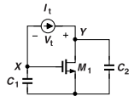


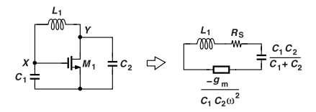



Three point oscillators
Def : Series combination of C1, C2 and Negative resistance
  Negative Resistance b/w X and Y
  M1 need not be grounded
  Voltage :
  Current :
  C2 carries a current :
  KVL gives Small signal resistance between X and Y
  Vc2 : Ic2 / C2S
Circuit exhibiting
negative resistance.
Three point oscillators
ω0 = $\frac{1}{\sqrt{LC}}=\frac{1}{\sqrt{L\{\frac{C1∗C2}{C1+C2}\}}}$
Rs = $\frac{gm}{C1∗C2∗{wo}^{2}}$ ;
Startup condition → Neg resistance should overcome tank loss Rs

Slide 17
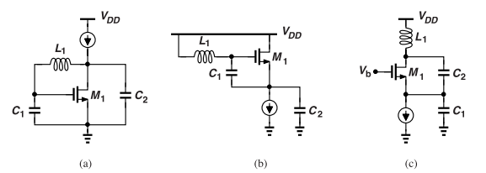

Wkt Rp = (L1 w0)^2 / Rs ;
gmRp = $\frac{{(C1+C2)}^{2}}{C1∗C2}$ => MINIMUM gmRp= 4 if C1=C2
Examples of three point oscillators :
CS with feedback
Source follower osc
CG with feedback (also called as Colpitts oscillator)

Slide 18






Voltage controlled oscillators
Oscillator’s frequency is tuned. → change Voltage, temperature, process etc.,,
Electronically vary → Capacitance, Inductance or resistance. Through Voltage!
VCO Basics:
  Frequency tuning : ωout ​= ω0​+Kvco​*Vcont​ => Represents a Static System
  Kvco = VCO gain (rad/s/V or Hz/V)
VCO O/p waveform and phase :
  Vout = Vo Cos(w1*t) ; => { w1t : phase is linear wrt time. }
  Vout is contant :
  Vout is varying wrt time :
    Freq :
: Phase Slope → w0 + Kvco*Vcont
Instantaneous O/p Frequency
Kvco is constant with time
This VCO acts as a freq modulator

Slide 19

Excess Phase
In PLLs, we are primarily interested in φex as the VCO output.
Definitions
Kvco : VCO gain ; VCO sensitivity ; How much o/p freq changes in response to input voltage change
Output phase : Instantaneous Phase angle of VCO o/p signal to time ‘t’
Excess Phase : Part of the output phase ; due to only the Vcont ; excludes reference linear phase (w0*t)
Centre freq w0 = o/p freq of VCO when Vcont=0 ; BASELINE

